Slide 1

Industrial Training
G.K.A.R.Shehana
GAHDSE232F-001

Slide 2

Sri Lanka Mobitel PLC
Vision
"All Sri Lankans seamlessly connected with world-class information, communication and entertainment services."
Mission
"Your trusted and proven partner for innovative and exciting communication experiences delivered with passion, quality and commitment."

Slide 3


What I Did
PHP Programming for SLT Visitors Entry Management System using Laravel Framework.
Write Test Cases for Nebula Student Management System.(Manual & Automation)
Implement Front-End Designs for the MySLT website using Bootstrap.
Create a SQL Database for Nebula Student Management System.
Study about BOC QMS System.

Slide 4
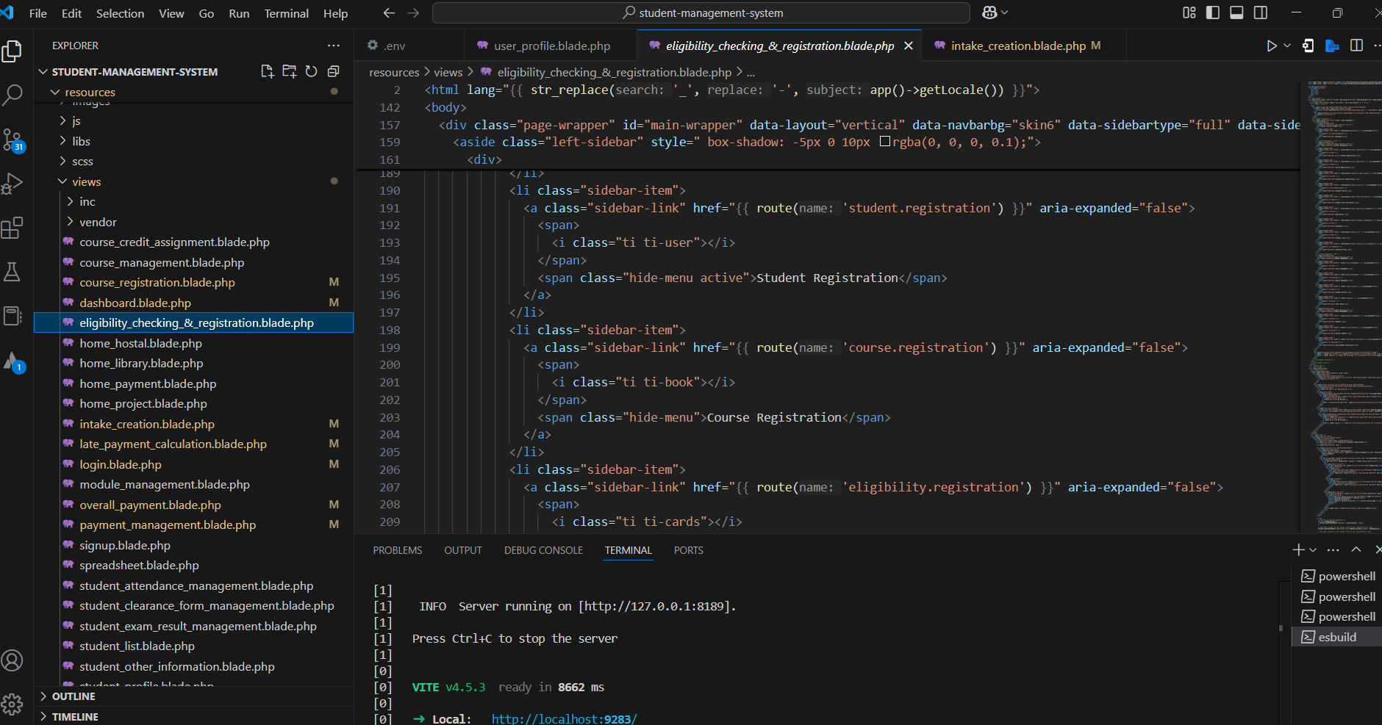
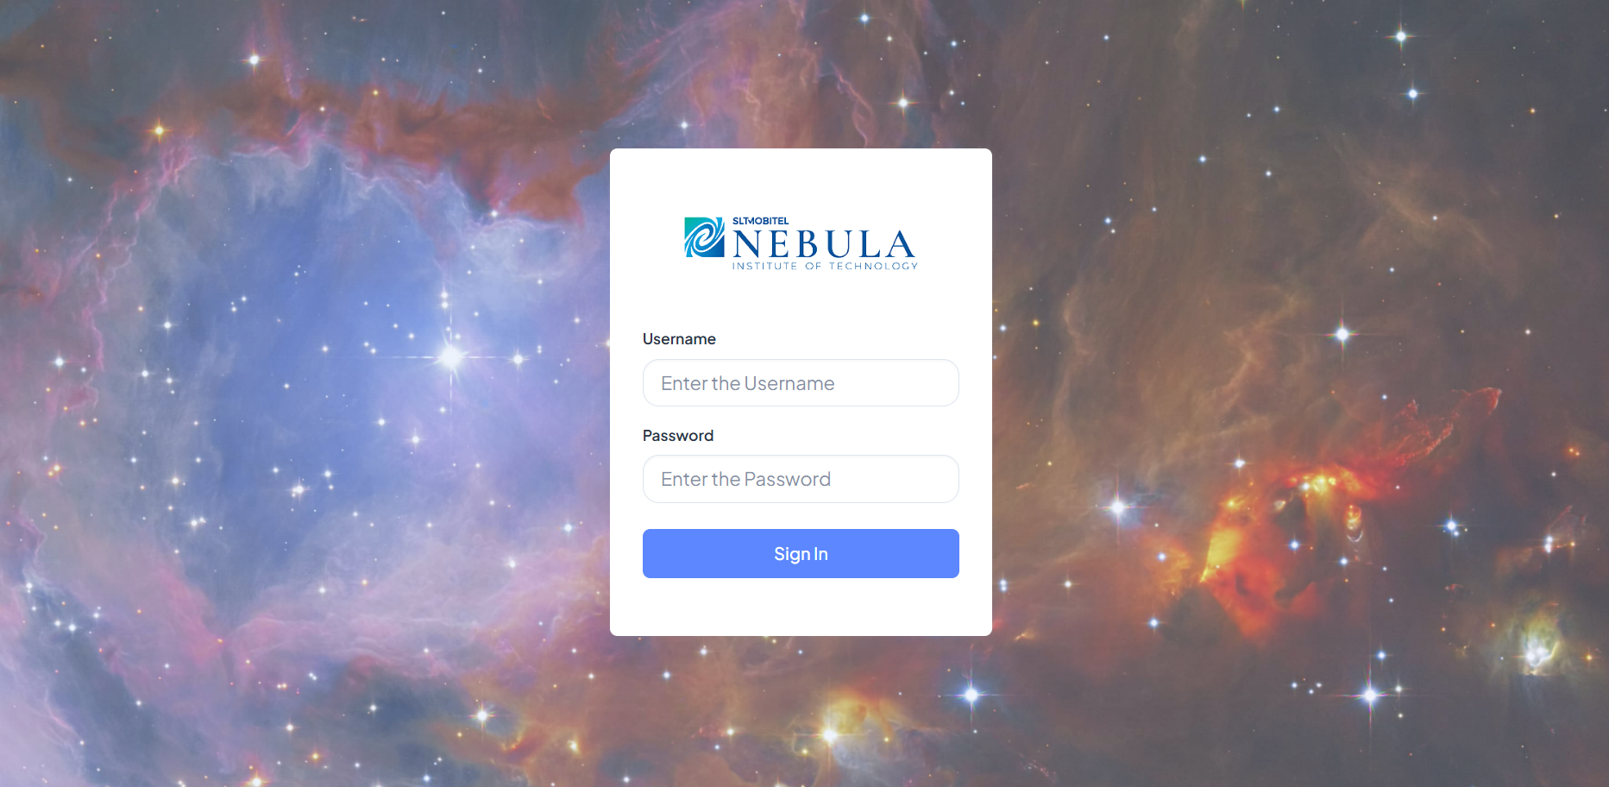
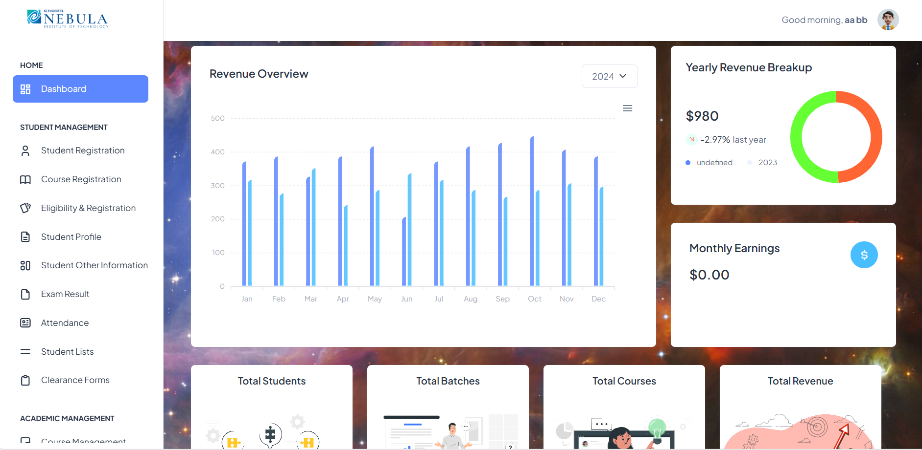
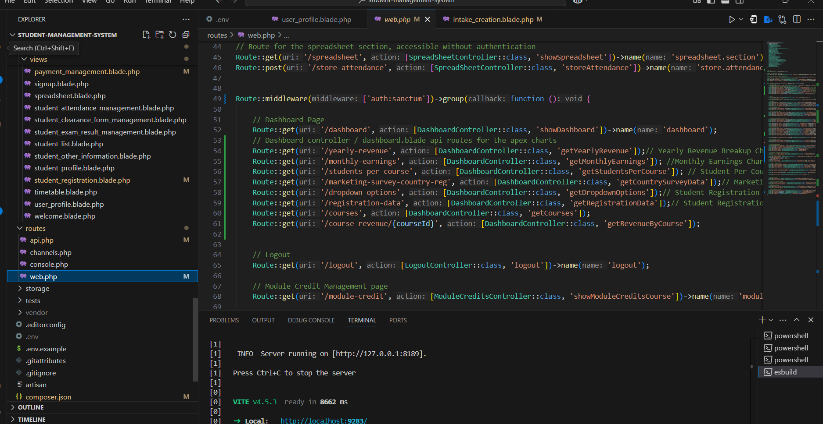
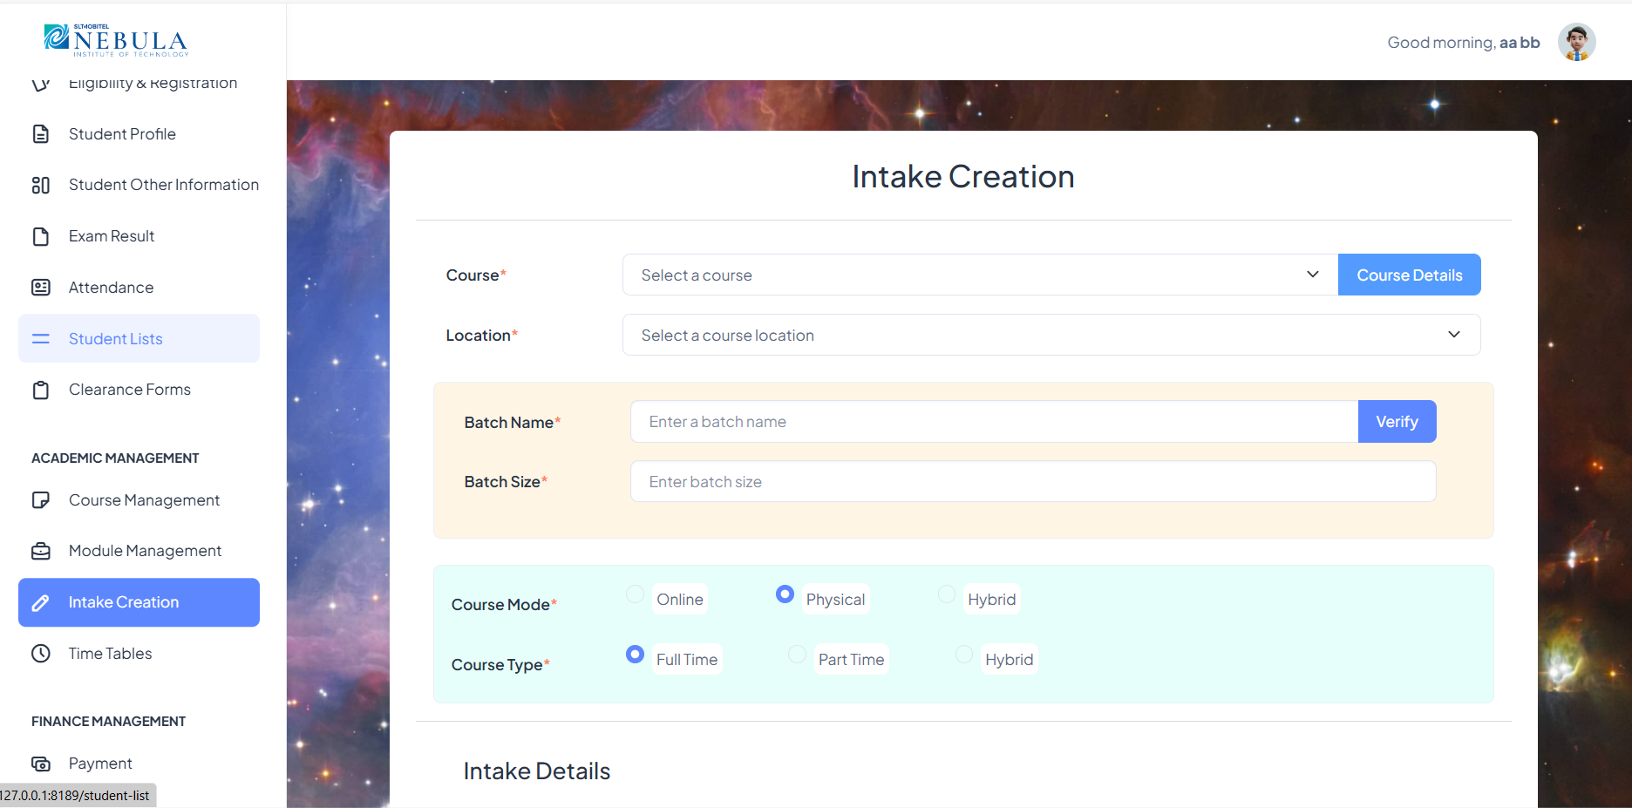
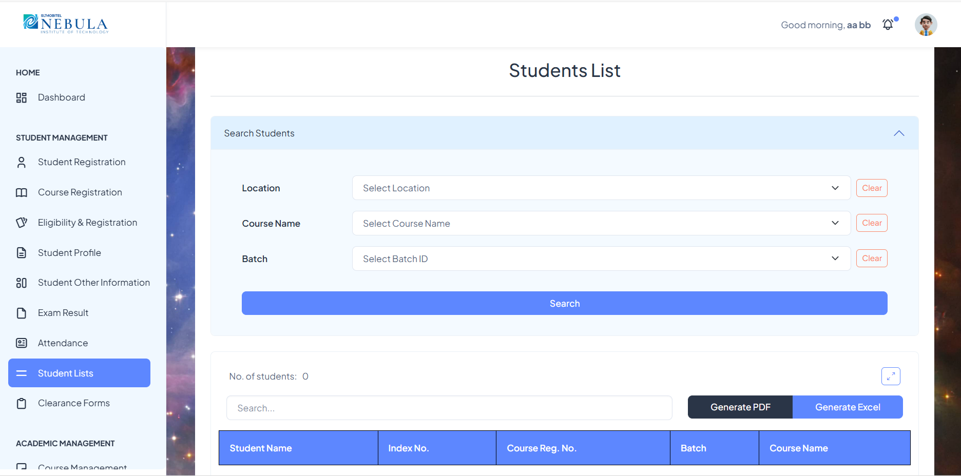
Nebula – Student Management System

Slide 5
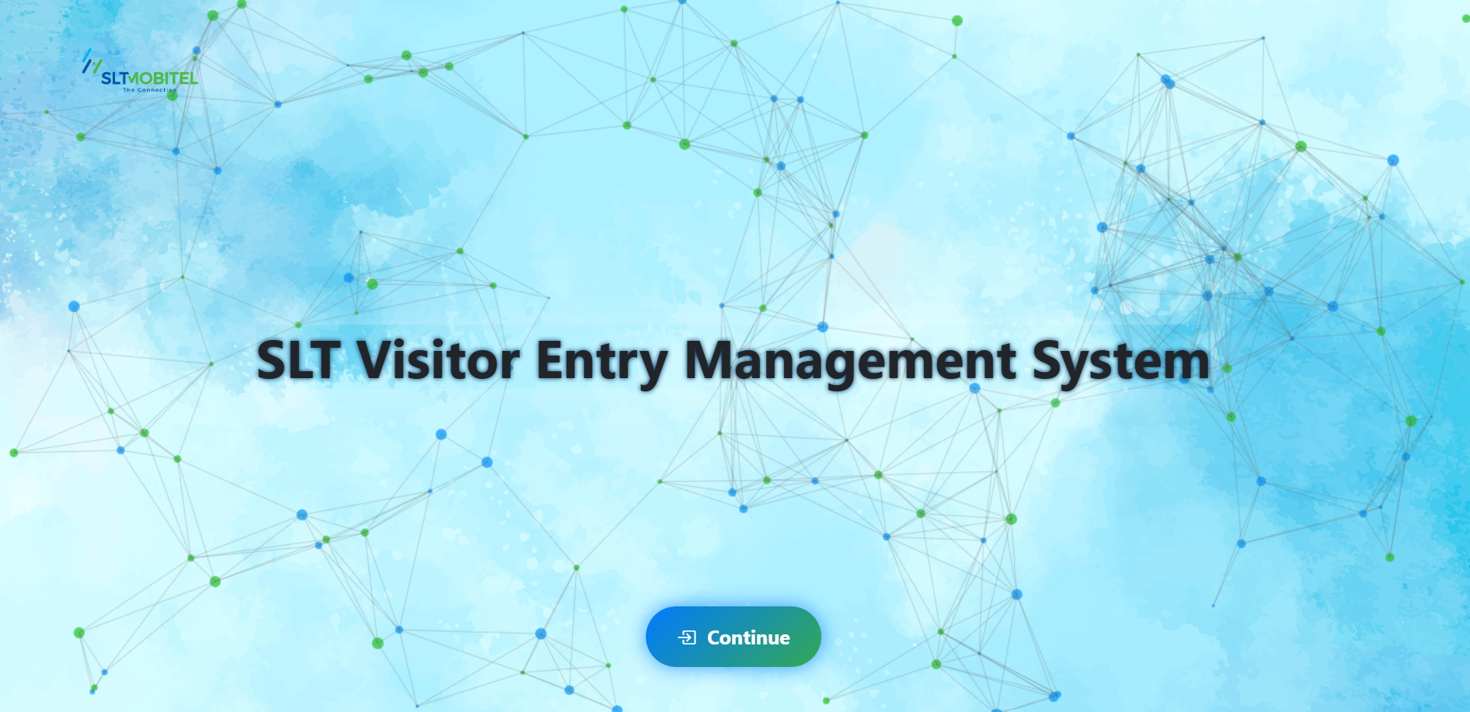
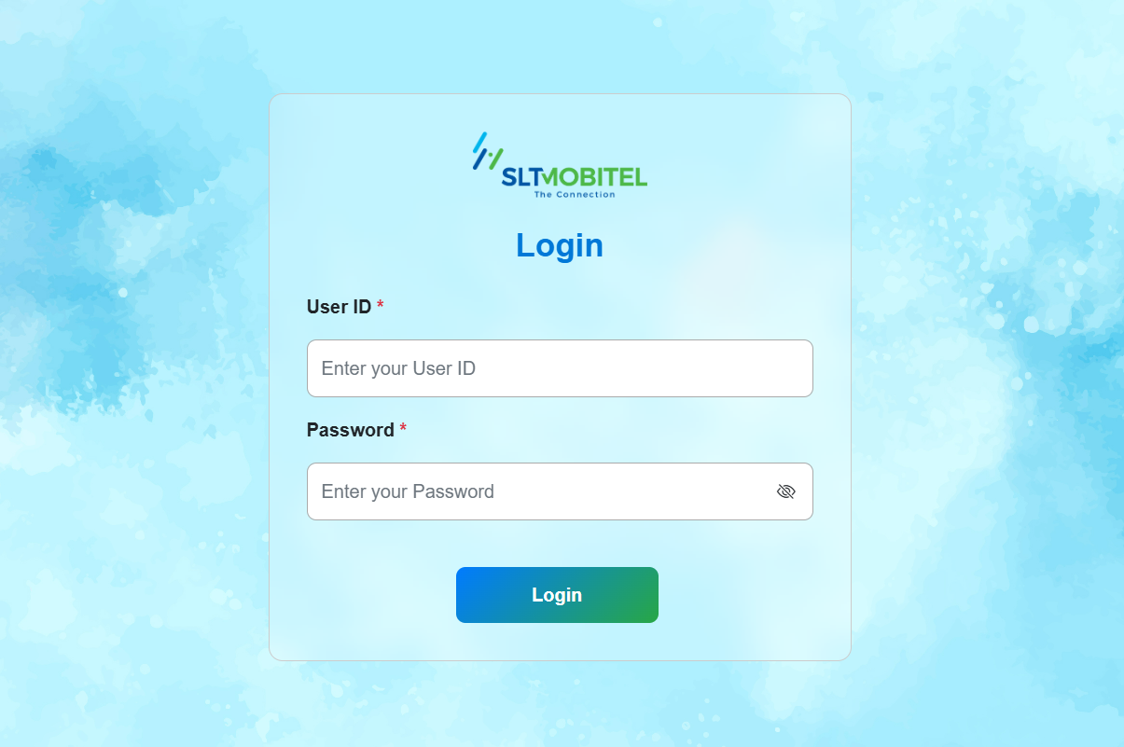
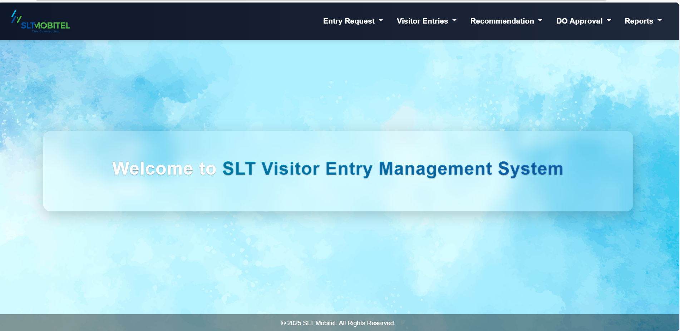
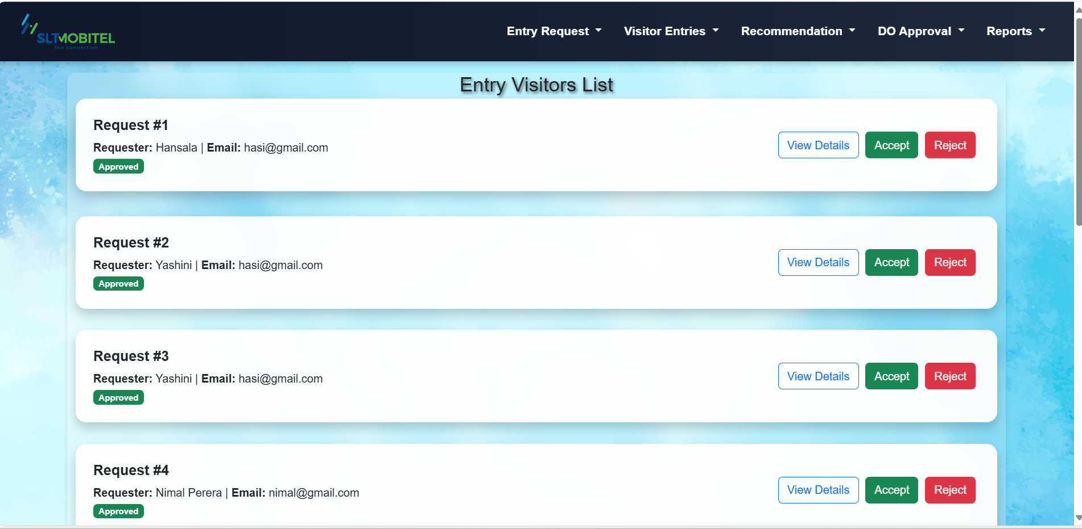
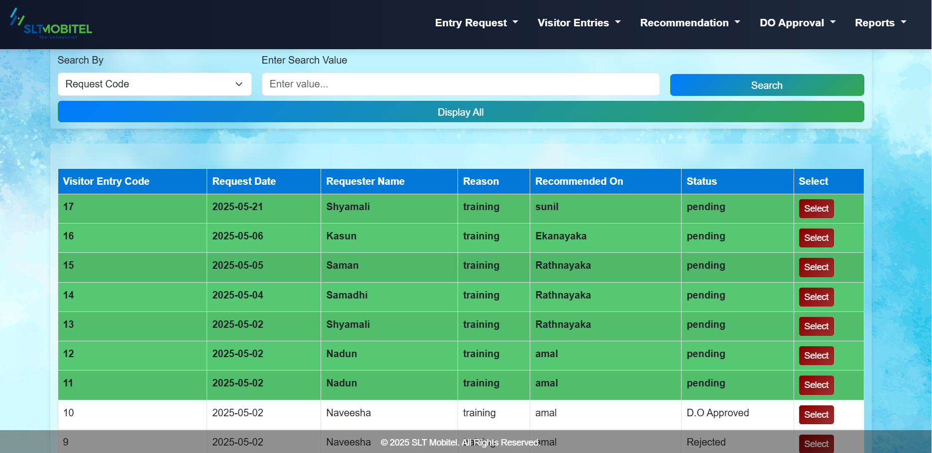
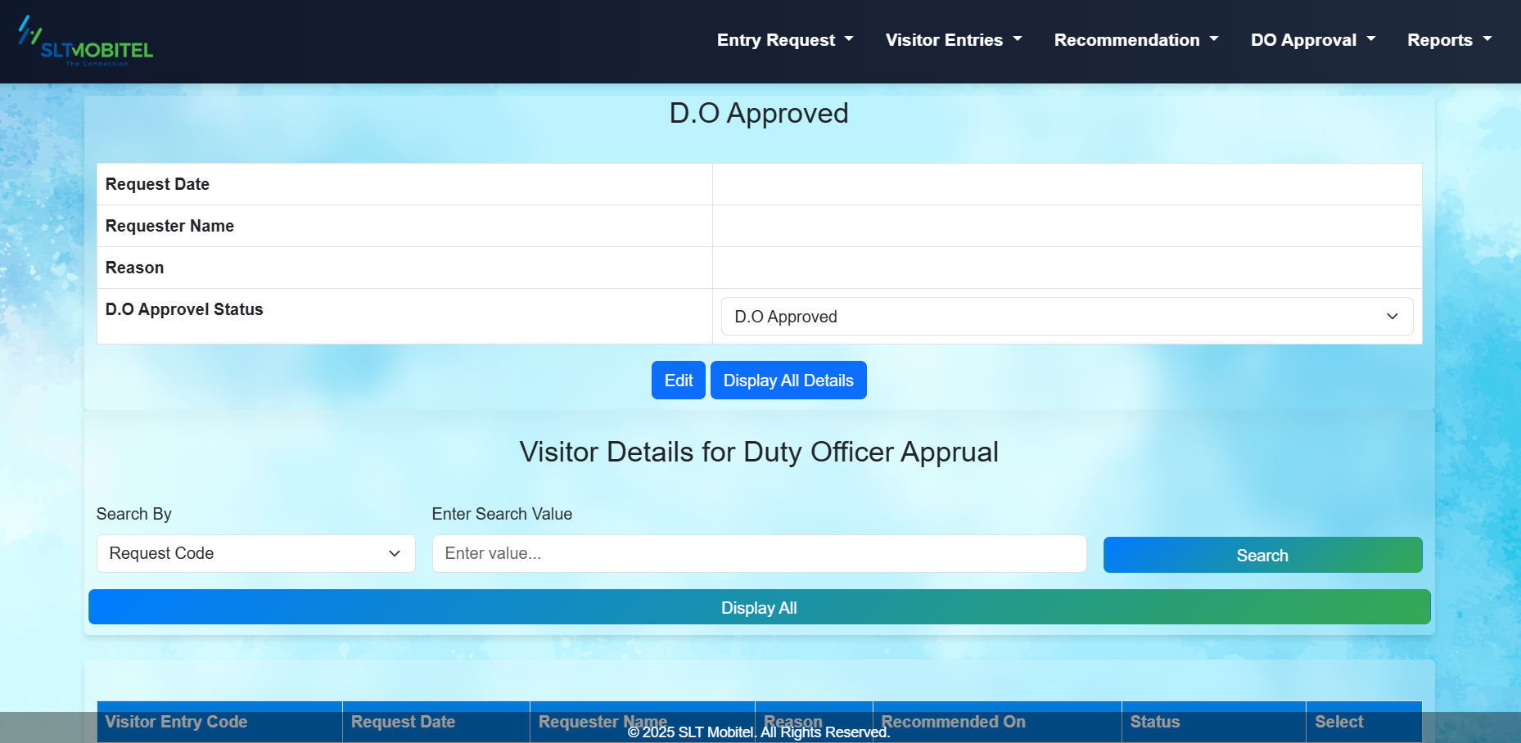
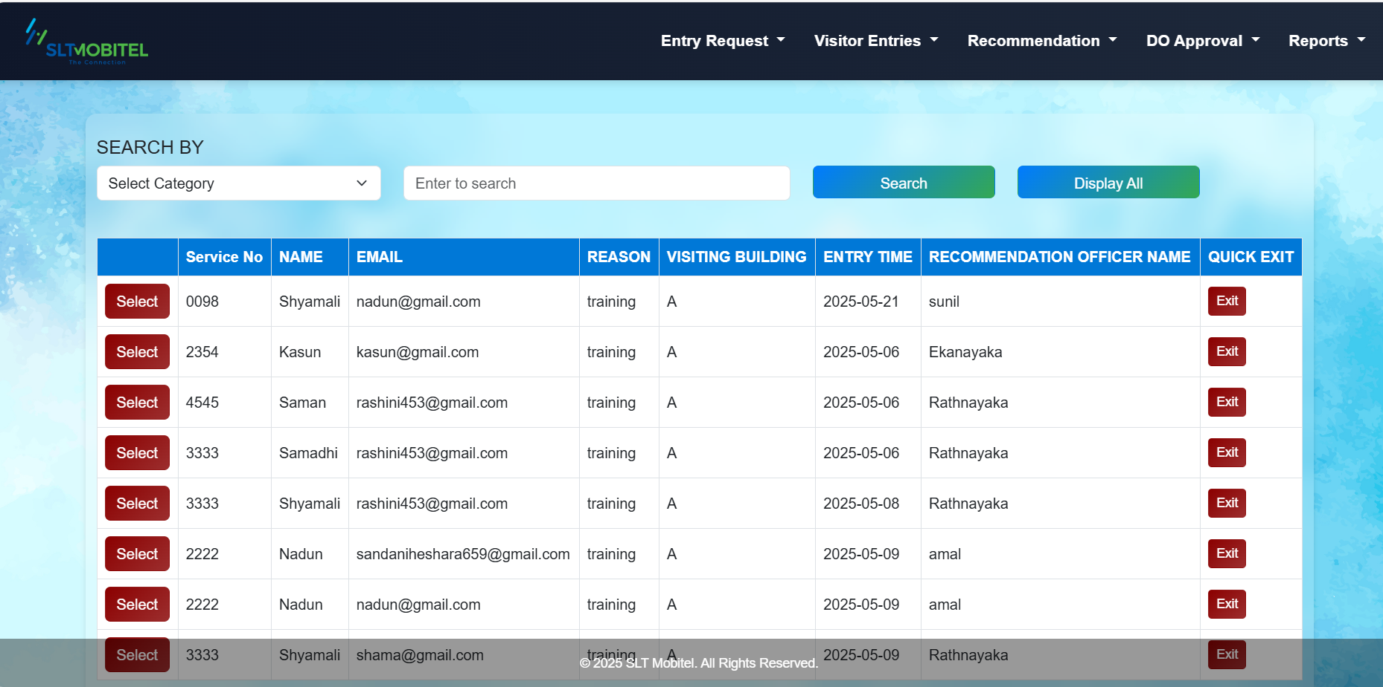
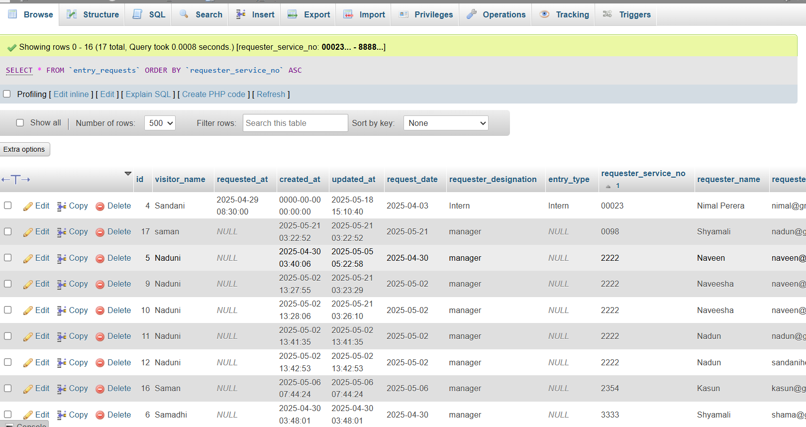
SLT Visitors Entry Management System

Slide 6
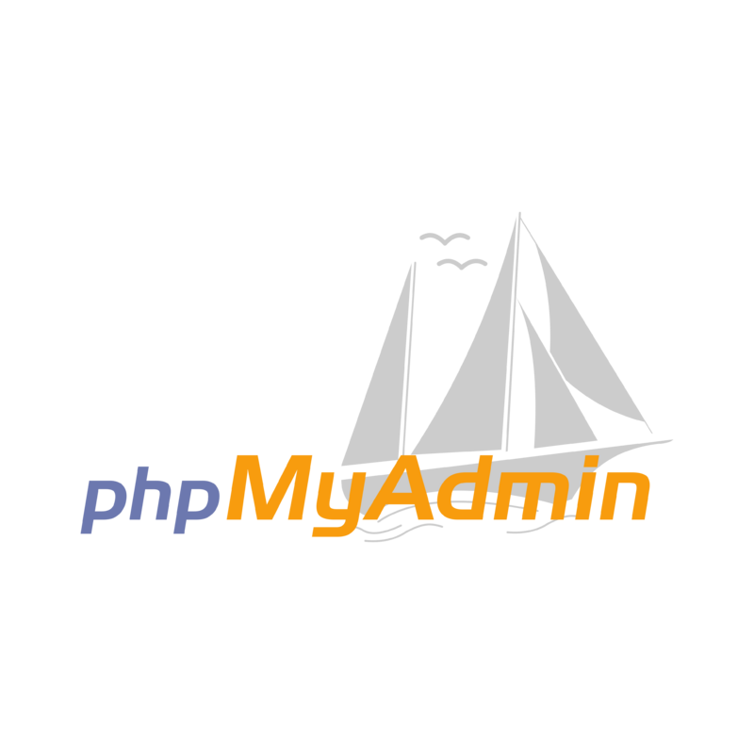
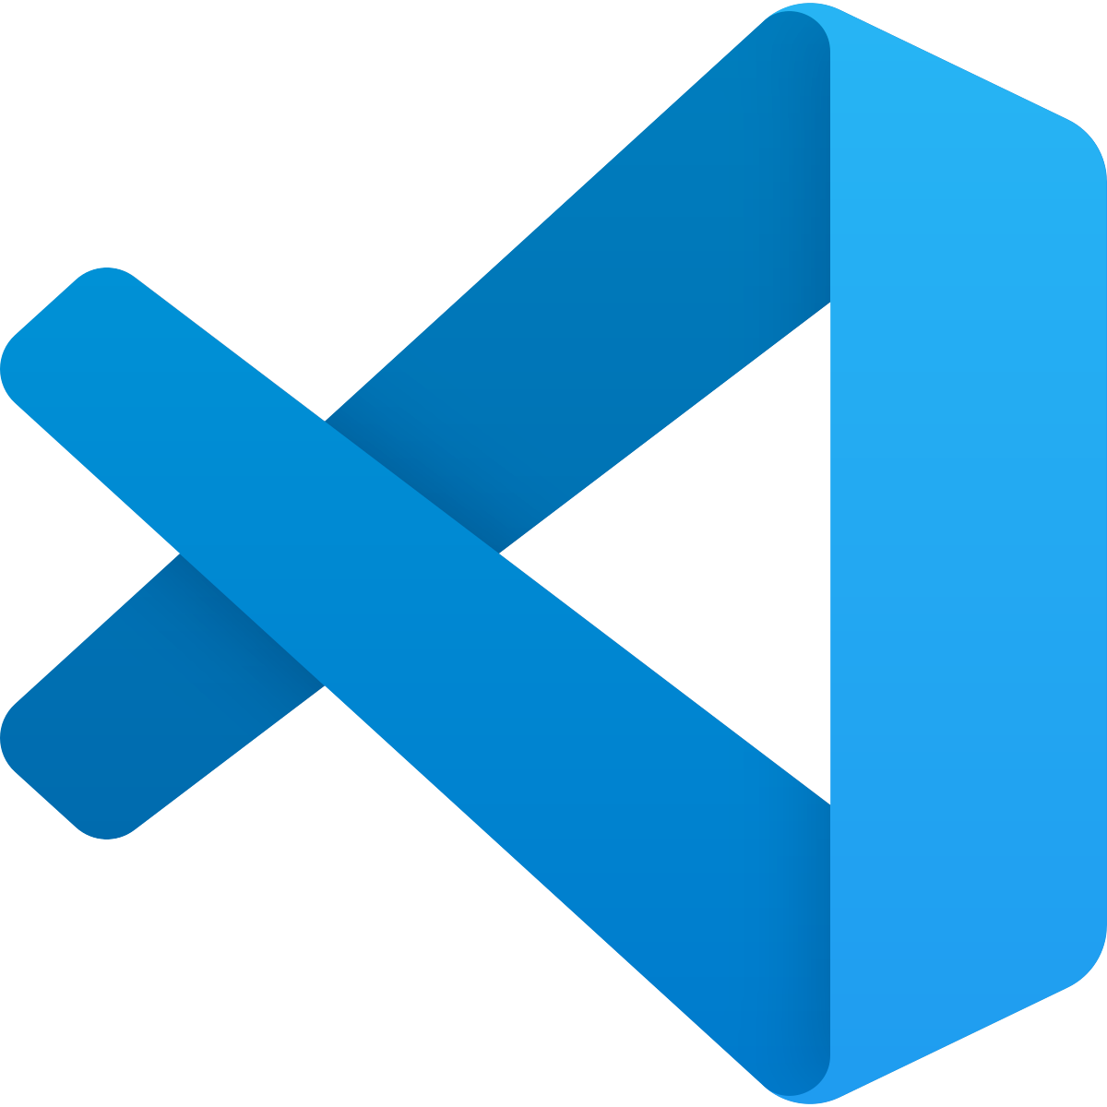



What I Used
Visual Studio Code
Xampp Server
Bitbucket Version Control System
phpMyAdmin
Postman API
Selenium IDE

Slide 7
Issues that I Faced
Less knowledge about Selenium IDE.
Securely hosting the web application using Azure.
Less knowledge about the Laravel Framework.
Complex form data handling.
I resolved these issues with the help of Google, AI Tools, and guidance from my assigned supervisor.

Slide 8
What I Learnt
Gained hands-on experience in frontend and backend development using Laravel Framework.
Learned about how to work with Selenium IDE and write the test cases.
Improved debugging skills by solving real-world issues like module errors, database connection problems, and integration bugs.
Worked well with the team and used feedback from my supervisor to improve the system.
Managed tasks to meet deadlines and complete assigned features on time.

Slide 9
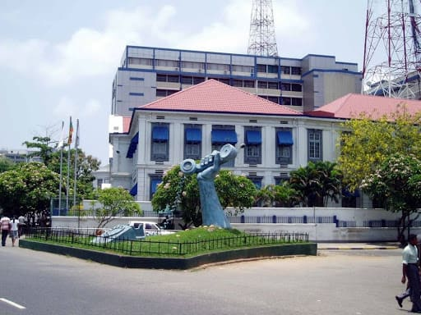
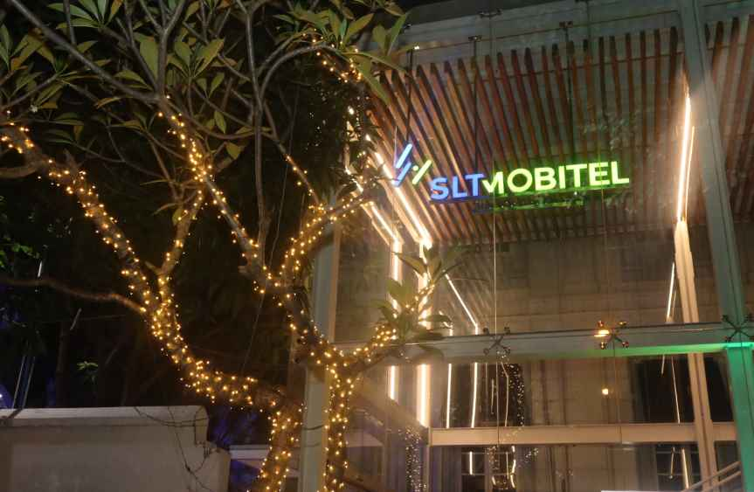
Thank You!

